Slide 1

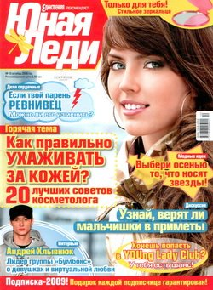
My favourite magazine

Slide 2



My favourite magazine is “Young Lady”.
It is very popular teenage magazine.
I read it every day and every time because it have a lot of useful information.

Slide 3

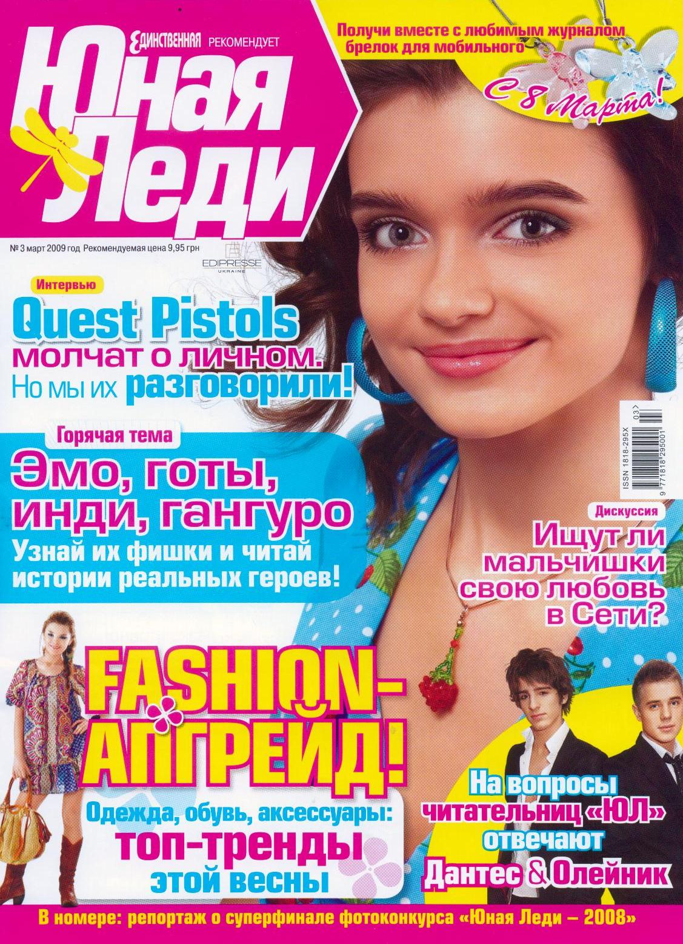
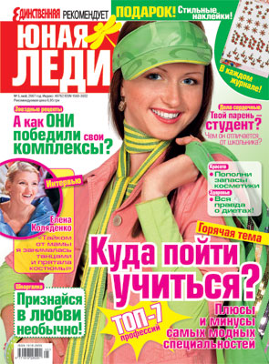

On first page it contain contents.
It very necessary for me
because I can find helpful tips at once.

Slide 4
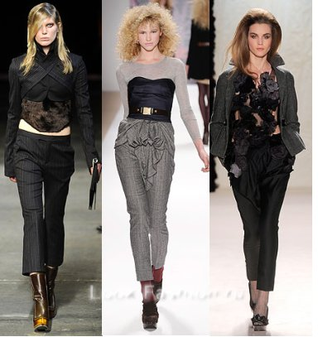
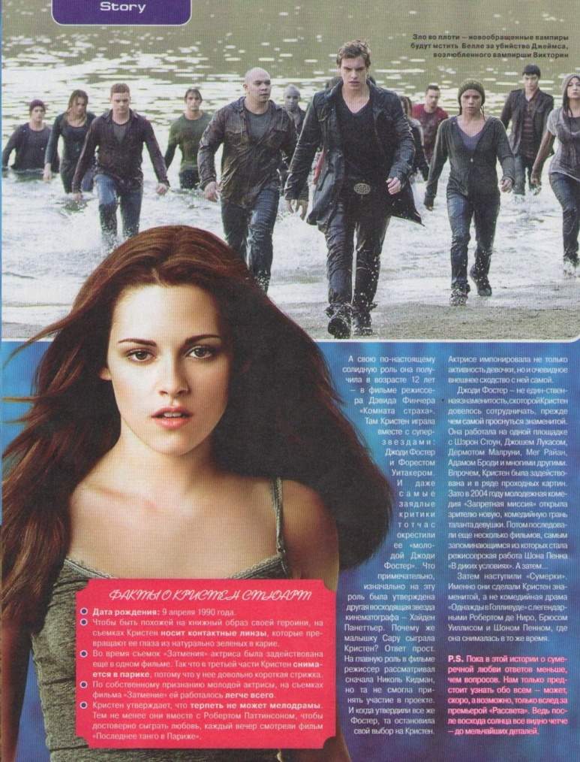
In every issue I can find something new and different.
There are fashion advices, interviews with well-known actors, singers, sportsmens, designers.
There is always a good piece of advice!

Slide 5


Also this magazine have very interesting tests and truethful horoscopes.
Thanks to it, I can now what have to happen with me!

Slide 6
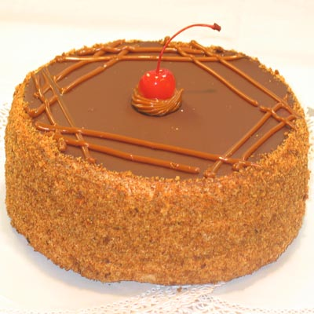
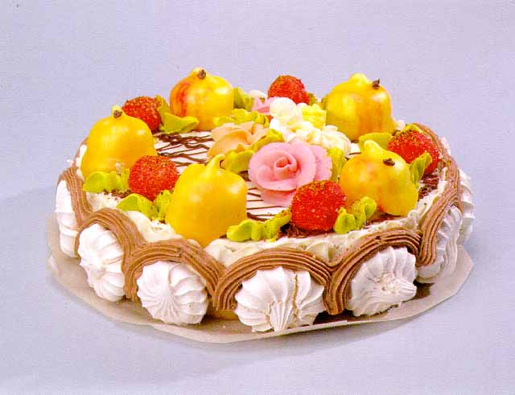
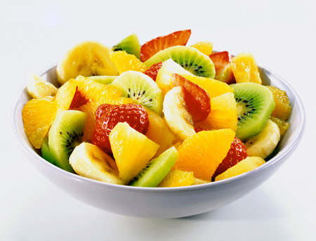
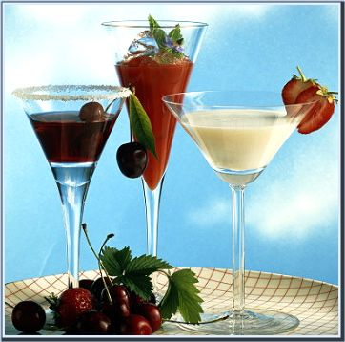
All columns in this magazine are very interesting, but
my favourite is cuisine. I like to cook very much and I often use advices from it.

Slide 7


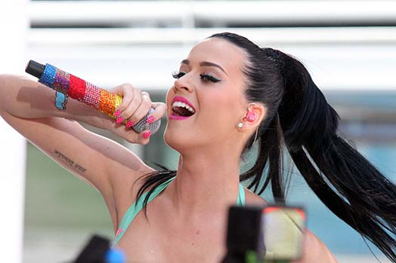
On the last page there are words of popular song.
I lIke this coulmn very mach too!

Slide 8
I like this magazine very mach and recommend to read it!

